Slide 1
Chapter 12
Pointers and Arrays

Slide 2
Introduction
C allows us to perform arithmetic—addition and subtraction—on pointers to array elements.
This leads to an alternative way of processing arrays in which pointers take the place of array subscripts.
The relationship between pointers and arrays in C is a close one.
Understanding this relationship is critical for mastering C.

Slide 3
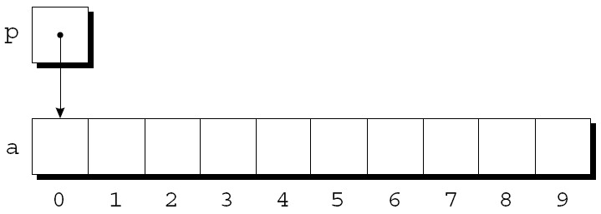
Pointer Arithmetic
Chapter 11 showed that pointers can point to array elements:
int a[10], *p;
p = &a[0];
A graphical representation:

Slide 4
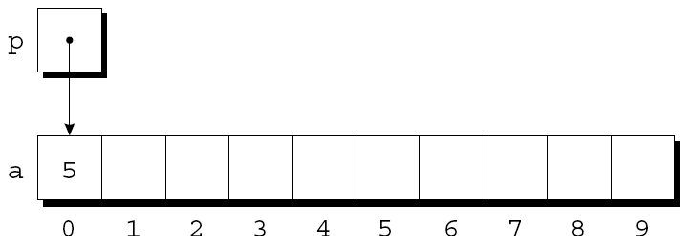
Pointer Arithmetic
We can now access a[0] through p; for example, we can store the value 5 in a[0] by writing
*p = 5;
An updated picture:

Slide 5
Pointer Arithmetic
If p points to an element of an array a, the other elements of a can be accessed by performing pointer arithmetic (or address arithmetic) on p.
C supports three (and only three) forms of pointer arithmetic:
Adding an integer to a pointer
Subtracting an integer from a pointer
Subtracting one pointer from another

Slide 6
Adding an Integer to a Pointer
Adding an integer j to a pointer p yields a pointer to the element j places after the one that p points to.
More precisely, if p points to the array element a[i], then p + j points to a[i+j].
Assume that the following declarations are in effect:
int a[10], *p, *q, i;

Slide 7
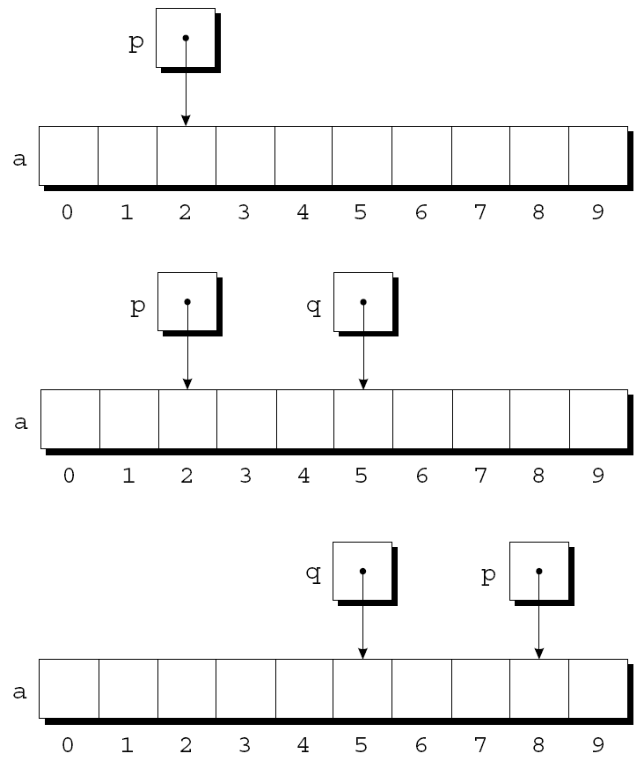
Adding an Integer to a Pointer
Example of pointer addition:
p = &a[2];
q = p + 3;
p += 6;

Slide 8
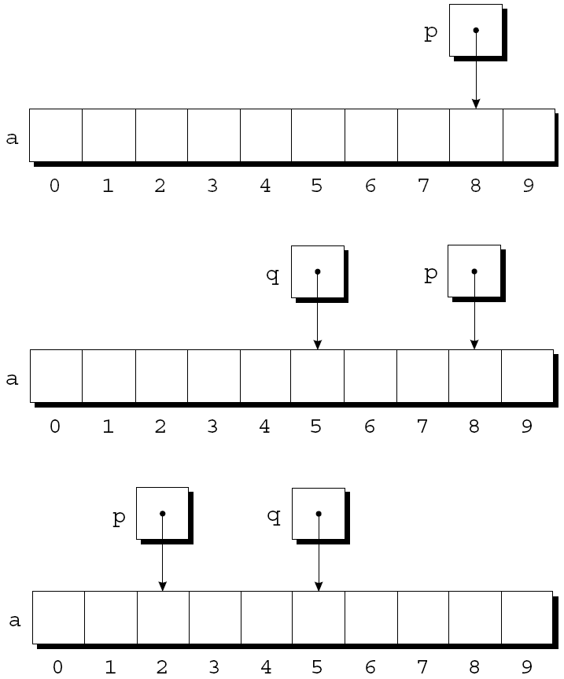
Subtracting an Integer from a Pointer
If p points to a[i], then p - j points to a[i-j].
Example:
p = &a[8];
q = p - 3;
p -= 6;

Slide 9
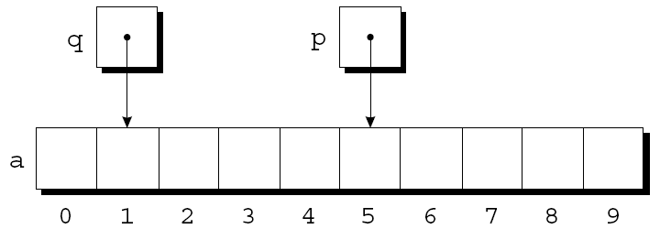
Subtracting One Pointer from Another
When one pointer is subtracted from another, the result is the distance (measured in array elements) between the pointers.
If p points to a[i] and q points to a[j], then p - q is equal to i - j.
Example:
p = &a[5];
q = &a[1];
i = p - q; /* i is 4 */
i = q - p; /* i is -4 */

Slide 10
Subtracting One Pointer from Another
Operations that cause undefined behavior:
Performing arithmetic on a pointer that doesn’t point to an array element
Subtracting pointers unless both point to elements of the same array

Slide 11
Comparing Pointers
Pointers can be compared using the relational operators (<, <=, >, >=) and the equality operators (== and !=).
Using relational operators is meaningful only for pointers to elements of the same array.
The outcome of the comparison depends on the relative positions of the two elements in the array.
After the assignments
p = &a[5];
q = &a[1];
the value of p <= q is 0 and the value of p >= q is 1.

Slide 12
Pointers to Compound Literals (C99)
It’s legal for a pointer to point to an element within an array created by a compound literal:
int *p = (int []){3, 0, 3, 4, 1};
Using a compound literal saves us the trouble of first declaring an array variable and then making p point to the first element of that array:
int a[] = {3, 0, 3, 4, 1};
int *p = &a[0];

Slide 13
Using Pointers for Array Processing
Pointer arithmetic allows us to visit the elements of an array by repeatedly incrementing a pointer variable.
A loop that sums the elements of an array a:
#define N 10
…
int a[N], sum, *p;
…
sum = 0;
for (p = &a[0]; p < &a[N]; p++)
sum += *p;

Slide 14
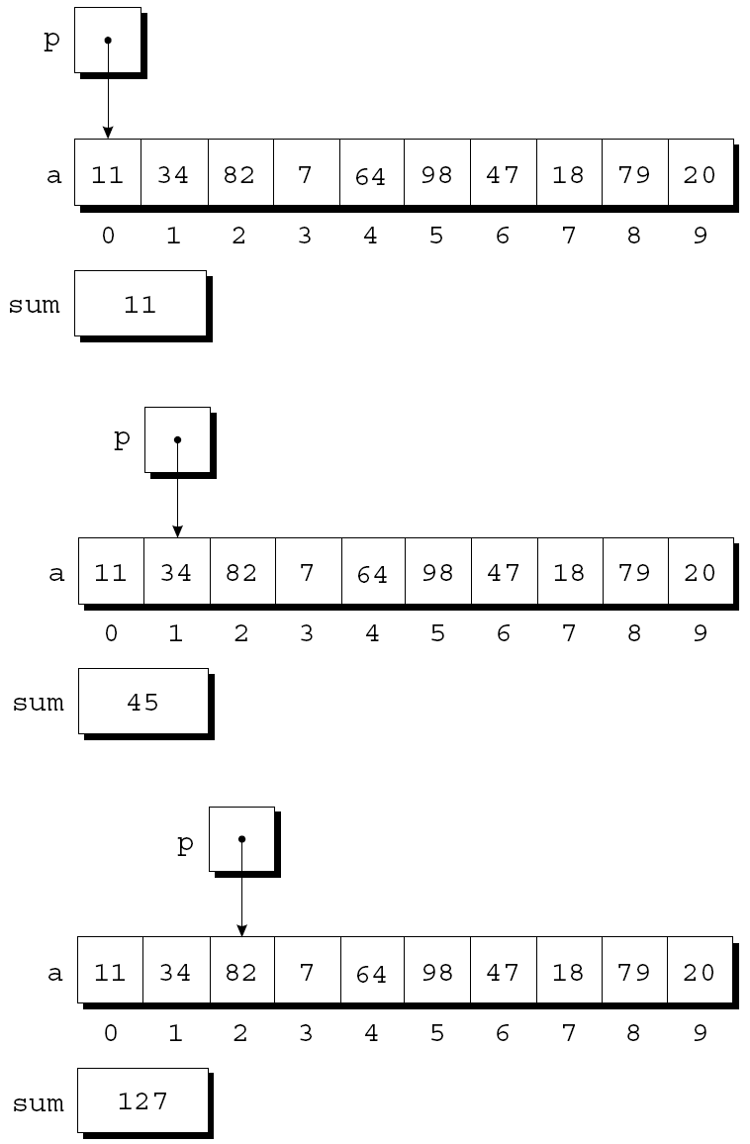
Using Pointers for Array Processing
At the end of the first iteration:
At the end of the second iteration:
At the end of the third iteration:

Slide 15
Using Pointers for Array Processing
The condition p < &a[N] in the for statement deserves special mention.
It’s legal to apply the address operator to a[N], even though this element doesn’t exist.
Pointer arithmetic may save execution time.
However, some C compilers produce better code for loops that rely on subscripting.

Slide 16
Combining the * and ++ Operators
C programmers often combine the * (indirection) and ++ operators.
A statement that modifies an array element and then advances to the next element:
a[i++] = j;
The corresponding pointer version:
*p++ = j;
Because the postfix version of ++ takes precedence over *, the compiler sees this as
*(p++) = j;

Slide 17
Combining the * and ++ Operators
Possible combinations of * and ++:
Expression Meaning
*p++ or *(p++) Value of expression is *p before increment;
increment p later
(*p)++ Value of expression is *p before increment;
increment *p later
*++p or *(++p) Increment p first;
value of expression is *p after increment
++*p or ++(*p) Increment *p first;
value of expression is *p after increment

Slide 18
Combining the * and ++ Operators
The most common combination of * and ++ is *p++, which is handy in loops.
Instead of writing
for (p = &a[0]; p < &a[N]; p++)
sum += *p;
to sum the elements of the array a, we could write
p = &a[0];
while (p < &a[N])
sum += *p++;

Slide 19
Combining the * and ++ Operators
The * and -- operators mix in the same way as * and ++.
For an application that combines * and --, let’s return to the stack example of Chapter 10.
The original version of the stack relied on an integer variable named top to keep track of the “top-of-stack” position in the contents array.
Let’s replace top by a pointer variable that points initially to element 0 of the contents array:
int *topPtr = &contents[0];

Slide 20
Combining the * and ++ Operators
The new push and pop functions:
void push(int i)
{
if (isFull())
stackOverflow();
else
*topPtr++ = i;
}
int pop(void)
{
if (isEmpty())
stackUunderflow();
else
return *--topPtr;
}
int *topPtr = &contents[0];

Slide 21
Using an Array Name as a Pointer
Pointer arithmetic is one way in which arrays and pointers are related.
Another key relationship:
The name of an array can be used as a pointer to the first element in the array.
This relationship simplifies pointer arithmetic and makes both arrays and pointers more versatile.

Slide 22
Using an Array Name as a Pointer
Suppose that a is declared as follows:
int a[10];
Examples of using a as a pointer:
*a = 7; /* stores 7 in a[0] */
*(a+1) = 12; /* stores 12 in a[1] */
In general, a + i is the same as &a[i].
Both represent a pointer to element i of a.
Also, *(a+i) is equivalent to a[i].
Both represent element i itself.

Slide 23
Using an Array Name as a Pointer
The fact that an array name can serve as a pointer makes it easier to write loops that step through an array.
Original loop:
for (p = &a[0]; p < &a[N]; p++)
sum += *p;
Simplified version:
for (p = a; p < a + N; p++)
sum += *p;

Slide 24
Using an Array Name as a Pointer
Although an array name can be used as a pointer, it’s not possible to assign it a new value.
Attempting to make it point elsewhere is an error:
while (*a != 0)
a++; /*** WRONG ***/
This is no great loss; we can always copy a into a pointer variable, then change the pointer variable:
p = a;
while (*p != 0)
p++;

Slide 25
Program: Reversing a Series of Numbers (Revisited)
The reverse.c program of Chapter 8 reads 10 numbers, then writes the numbers in reverse order.
The original program stores the numbers in an array, with subscripting used to access elements of the array.
reverse3.c is a new version of the program in which subscripting has been replaced with pointer arithmetic.

Slide 26
/* Reverses a series of numbers (pointer version) */
#include <stdio.h>
#define N 10
int main(void)
{
int a[N], *p;
printf("Enter %d numbers: ", N);
for (p = a; p < a + N; p++) scanf("%d", p);
printf("In reverse order:");
for(p= a+N-1; p>= a; p--) printf(" %d", *p);
printf("\n");
return 0;
}
reverse3.c

Slide 27
Array Arguments (Revisited)
When passed to a function, an array name is treated as a pointer.
Example:
int findLargest(int a[], int n)
{
int i, max;
max = a[0];
for (i = 1; i < n; i++)
if (a[i] > max)
max = a[i];
return max;
}
A call of findLargest:
largest = findLargest(b, N);
This call causes a pointer to the first element of b to be assigned to a; the array itself isn’t copied.

Slide 28
Array Arguments (Revisited)
The fact that an array argument is treated as a pointer has some important consequences.
Consequence 1:
When an ordinary variable is passed to a function, its value is copied; any changes to the corresponding parameter don’t affect the variable.
In contrast, an array used as an argument isn’t protected against change.

Slide 29
Array Arguments (Revisited)
For example, the following function modifies an array by storing zero into each of its elements:
void store_zeros(int a[], int n)
{
int i;
for (i = 0; i < n; i++)
a[i] = 0;
}

Slide 30
Array Arguments (Revisited)
To indicate that an array parameter won’t be changed, we can include the word const in its declaration:
int findLargest(const int a[], int n)
{
…
}
If const is present, the compiler will check that no assignment to an element of a appears in the body of findLargest.

Slide 31
Array Arguments (Revisited)
Consequence 2:
The time required to pass an array to a function doesn’t depend on the size of the array.
There’s no penalty for passing a large array, since no copy of the array is made.

Slide 32
Array Arguments (Revisited)
Consequence 3:
An array parameter can be declared as a pointer if desired.
findLargest could be defined as follows:
int findLargest(int *a, int n)
{
…
}
Declaring a to be a pointer is equivalent to declaring it to be an array; the compiler treats the declarations as though they were identical.

Slide 33
Array Arguments (Revisited)
Although declaring a parameter to be an array is the same as declaring it to be a pointer, the same isn’t true for a variable.
The following declaration causes the compiler to set aside space for 10 integers:
int a[10];
The following declaration causes the compiler to allocate space for a pointer variable:
int *a;

Slide 34
Array Arguments (Revisited)
In the latter case, a is not an array; attempting to use it as an array can have disastrous results.
For example, the assignment
*a = 0; /*** WRONG ***/
will store 0 where a is pointing.
Since we don’t know where a is pointing, the effect on the program is undefined.

Slide 35
Array Arguments (Revisited)
Consequence 4:
A function with an array parameter can be passed an array “slice”—a sequence of consecutive elements.
An example that applies findLargest to elements 5 through 14 of an array b:
largest = findLargest(&b[5], 10);
int findLargest(int *a, int n)
{
…
}

Slide 36
Using a Pointer as an Array Name
C allows us to subscript a pointer as though it were an array name:
#define N 10
…
int a[N], i, sum = 0, *p = a;
…
for (i = 0; i < N; i++)
sum += p[i];
The compiler treats p[i] as *(p+i).

Slide 37
Pointers and Multidimensional Arrays
Just as pointers can point to elements of one-dimensional arrays, they can also point to elements of multidimensional arrays.
This section explores common techniques for using pointers to process the elements of multidimensional arrays.

Slide 38
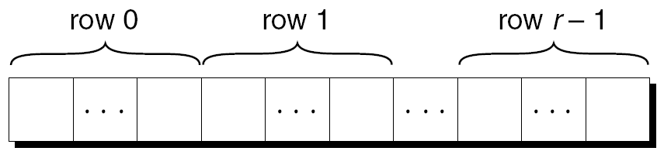
Processing the Elements of a Multidimensional Array
Chapter 8 showed that C stores two-dimensional arrays in row-major order.
Layout of an array with r rows:
If p initially points to the element in row 0, column 0, we can visit every element in the array by incrementing p repeatedly.

Slide 39
Processing the Elements of a Multidimensional Array
Consider the problem of initializing all elements of the following array to zero:
int a[NUM_ROWS][NUM_COLS];
The obvious technique would be to use nested for loops:
int row, col;
…
for (row = 0; row < NUM_ROWS; row++)
for (col = 0; col < NUM_COLS; col++)
a[row][col] = 0;
If we view a as a one-dimensional array of integers, a single loop is sufficient:
int *p;
…
for (p = &a[0][0]; p <= &a[NUM_ROWS-1][NUM_COLS-1]; p++)
*p = 0;

Slide 40
Processing the Elements of a Multidimensional Array
Although treating a two-dimensional array as one-dimensional may seem like cheating, it works with most C compilers.
Techniques like this one definitely hurt program readability, but—at least with some older compilers—produce a compensating increase in efficiency.
With many modern compilers, though, there’s often little or no speed advantage.

Slide 41
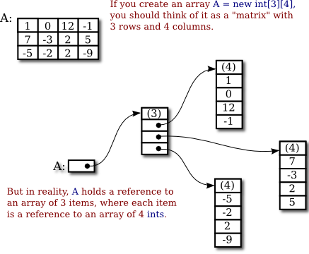
Processing the Rows of a Multidimensional Array
A pointer variable p can also be used for processing the elements in just one row of a two-dimensional array.
To visit the elements of row i, we’d initialize p to point to element 0 in row i in the array a:
p = &a[i][0];
or we could simply write
p = a[i];
a is of type:
int (*)[NUM_COLS]

Slide 42
Processing the Rows of a Multidimensional Array
For any two-dimensional array a, the expression a[i] is a pointer to the first element in row i.
To see why this works, recall that a[i] is equivalent to *(a + i).
Thus, &a[i][0] is the same as &(*(a[i] + 0)), which is equivalent to &*a[i].
This is the same as a[i], since the & and * operators cancel.

Slide 43
Processing the Rows of a Multidimensional Array
A loop that clears row i of the array a:
int a[NUM_ROWS][NUM_COLS], *p, i;
…
for (p = a[i]; p < a[i] + NUM_COLS; p++)
*p = 0;
Since a[i] is a pointer to row i of the array a, we can pass a[i] to a function that’s expecting a one-dimensional array as its argument.
In other words, a function that’s designed to work with one-dimensional arrays will also work with a row belonging to a two-dimensional array.

Slide 44
Processing the Rows of a Multidimensional Array
Consider findLargest, which was originally designed to find the largest element of a one-dimensional array.
We can just as easily use findLargest to determine the largest element in row i of the two-dimensional array a:
largest = findLargest(a[i], NUM_COLS);

Slide 45
Processing the Columns of a Multidimensional Array
Processing the elements in a column of a two-dimensional array isn’t as easy, because arrays are stored by row, not by column.
A loop that clears column i of the array a:
int a[NUM_ROWS][NUM_COLS], (*p)[NUM_COLS], i;
…
for (p = &a[0]; p < &a[NUM_ROWS]; p++)
(*p)[i] = 0;
pointer to an integer array of length NUM_COLS

Slide 46
int a[NUM_ROWS][NUM_COLS], (*p)[NUM_COLS], i=3;
for (p = &a[0]; p < &a[NUM_ROWS]; p++)
(*p)[i] = 0;
VS.
int a[NUM_ROWS][NUM_COLS], i= 3;
int *p;
for (p = &(a[0][0]); p < &(a[NUM_ROWS][NUM_COLS]); p += NUM_COLS)
*(p + i) = i;

Slide 47
Using the Name of a Multidimensional Array as a Pointer
The name of any array can be used as a pointer, regardless of how many dimensions it has, but some care is required.
Example:
int a[NUM_ROWS][NUM_COLS];
a is not a pointer to a[0][0]; instead, it’s a pointer to a[0].
C regards a as a one-dimensional array whose elements are one-dimensional arrays.
When used as a pointer, a has type int (*)[NUM_COLS] (pointer to an integer array of length NUM_COLS).

Slide 48
Using the Name of a Multidimensional Array as a Pointer
Knowing that a points to a[0] is useful for simplifying loops that process the elements of a two-dimensional array.
Instead of writing
for (p = &a[0]; p < &a[NUM_ROWS]; p++)
(*p)[i] = 0;
to clear column i of the array a, we can write
for (p = a; p < a + NUM_ROWS; p++)
(*p)[i] = 0;

Slide 49
Using the Name of a Multidimensional Array as a Pointer
We can “trick” a function into thinking that a multidimensional array is really one-dimensional.
A first attempt at using using findLargest to find the largest element in a:
largest = findLargest(a, NUM_ROWS * NUM_COLS); /* WRONG */
This an error, because the type of a is int (*)[NUM_COLS] but findLargest is expecting an argument of type int *.
The correct call:
largest = find_largest(a[0], NUM_ROWS * NUM_COLS);
a[0] points to element 0 in row 0, and it has type int * (after conversion by the compiler).

Slide 50
#include <stdio.h>
int main(){
int a[2][2] = {1, 2, 3, 4};
printf("a:%p, &a:%p, *a:%p \n", a, &a, *a);
printf("a[0]:%p, &a[0]:%p \n", a[0], &a[0]);
printf("&a[0][0]:%p \n", &a[0][0]);
return 0;
}
a:0028FEAC, &a:0028FEAC, *a:0028FEAC
a[0]:0028FEAC, &a[0]:0028FEAC
&a[0][0]:0028FEAC

Slide 51
#include <stdio.h>
void main(void)
{
int a[5] = {0};
printf("a---------->%p\n", a);
printf("&a--------->%p\n", &a);
printf("&a[0]------>%p\n", &a[0]);
printf("\nafter changed\n\n");
printf("a+1-------->%p\n", a + 1);
printf("&a+1------->%p\n", &a + 1);
printf("&a[0]+1---->%p\n", &a[0]+1);
}
Assume the address of a is
0x004DF870

Slide 52
a---------->004DF870
&a--------->004DF870
&a[0]------>004DF870
after changed
a+1-------->004DF874 //+4，size of int
&a+1------->004DF884 //+20，5*sizeof(int)
&a[0]+1---->004DF874 //+4，equivalent to a+1

